Slide 1
Week 3 Classroom Session

Slide 2
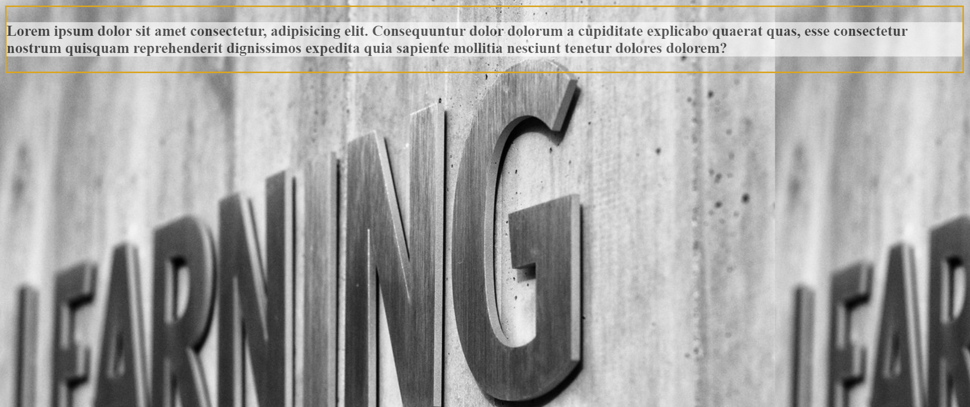
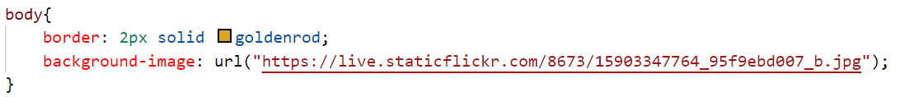
Background Image
We can set background image to the web page in various ways.
We can select image from
local images
online images
Syntax:
background-image: url("image name");
background-image: url("url here");
background-repeat: repeat-x;
background-repeat: repeat-y;
background-repeat: no-repeat;

Slide 3
Simple Animation
In CSS we can perform animations.
Animation is nothing but changing one style of a html tag to another style.
We use @keyframe to specify the new style to which the current style has to be transformed.
To bind the new style to html tags we use animation name (animation-name: name here).
We will define the animation properties like duration, delay start, no of repetitions,..etc in the html tag styling selector.
Example of div tag styling:
.abc{
animation-name: colorchange; // binding the keyframe with class
animation-duration: 4s; // animation will run for 4 seconds
animation-delay: 1s; // animation will start 1 second late
animation-iteration-count: infinite; // animation will repeat infinite times
}
@keyframes colorchange {
from{background-color: green;}
to{background-color: hotpink;}
}

Slide 4
Selectors and Its Types
Selectors are used to select a particular html tag and apply CSS properties to it.
We can declare selectors in 5 various ways. They are,
Simple selectors
Combinator selectors
Pseudo-class selectors
Pseudo-elements selectors
Attribute selectors

Slide 5
Simple Selector
To style paragraph tag from the html page we use as shown below in internal or external styling.
We will be able to set the same property to all the selectors of p tag this way.
p{
background-color: green;
font-color: blue;
}
Similarly we can style headers, div blocks and many more..,

Slide 6
Combinator Selectors
The Combinator selector has more than one simple selector with a combinator which explains the relation between the two selectors.
Syntax:
Selector_1 combinator Selector_2
{
property: value
}
There are four combinators in CSS. They are:
Descendant Selector (space): Styles all the children and grandchildren.
Child Selector (>): Styles all the children only
Adjacent Sibling Selector (+): Styles the first adjacent sibling only of selector 1
General Sibling Selector (~): Styles all the siblings after selector_1

Slide 7
Pseudo Class Selector
We have around 31 types of pseudo class selectors.
Some of them are,
visited
unvisited
hover
active
focus
nth-child(even/odd/number)
first-child
last-child
…
…
…

Slide 8
Pseudo Class Selector
This selector joins selector_1 and selector_2 with : (colon)
Syntax:
selector_1:Selector_2{}
Example:
a:nth-child(even/odd/number){}
a:first-child{} //styles first a tag
p:last-child{} //styles last p tag

Slide 9
Pseudo element Selector
This selector joins selector_1 and selector_2 with double colon (::)
Syntax:
selector_1::selector_2{}
Example:
p::after{content: “”}
p::before{content: “”}
p::selection{}
p::first-letter{}
p::first-line{}
p::marker{}

Slide 10
Attribute Selector
Selectors are used to select a specific tag to style based on the attributes like tag name, class name, id name, title, etc.,
Example:
a[target] //style based on anchor tag target
[class = “car”] //style based on class name
[title~="car"]{} //style based on space separated words only
[class|="car"] {} //style based on space or hyphen separated words
[id^="car"] {} //style based on starting characters of the word
[title$="lor"] {} //style based on ending characters of the word
[title*="lor"] {} //style based on any characters of the word

Slide 11
Problem Statement 1
Create a Electricity Board Complaint form for a state(Bangalore) using html, CSS and its various selectors
Create a header where the title of the form and instructions to fill the form are provided.
Create the form with
Name
Meter Id
Phone No
Email Id
Address with H-No, Street, Area, District(list) as one element
Checkbox for complaint Type (over charging, meter broken, hard copy not given, meter closing issue)
radio button to check how old the connection is.
Complaint description
Your availability with time
Make sure all the required validation are there
Submit and reset button with copyright at the end

Slide 12
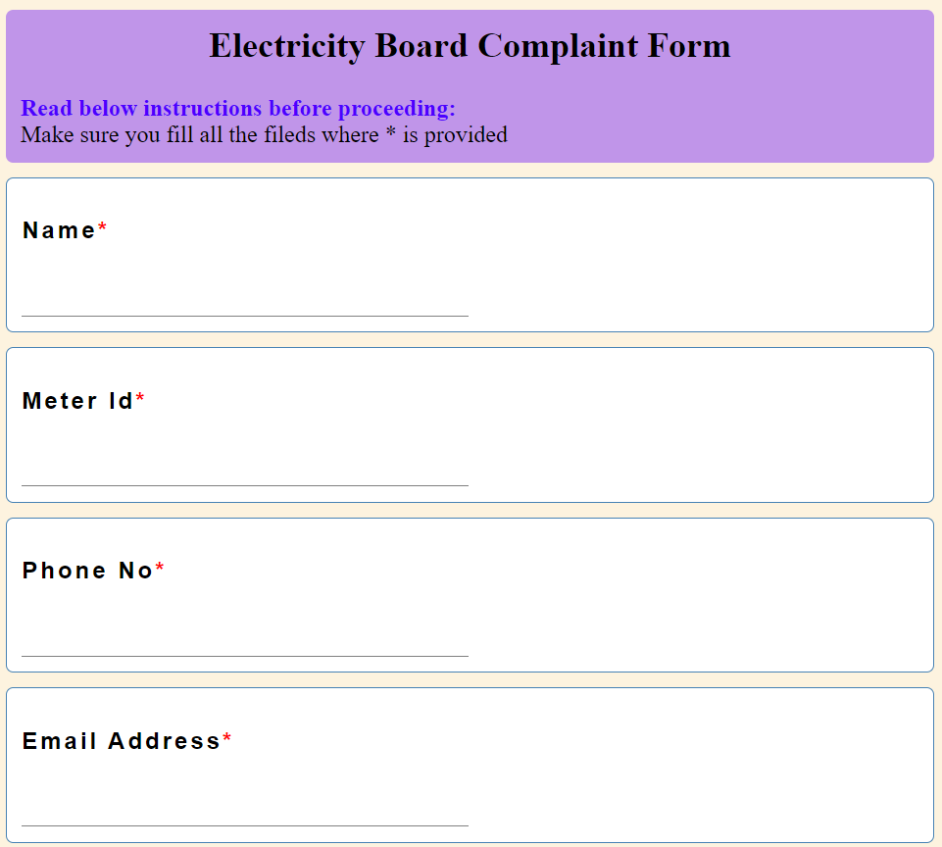
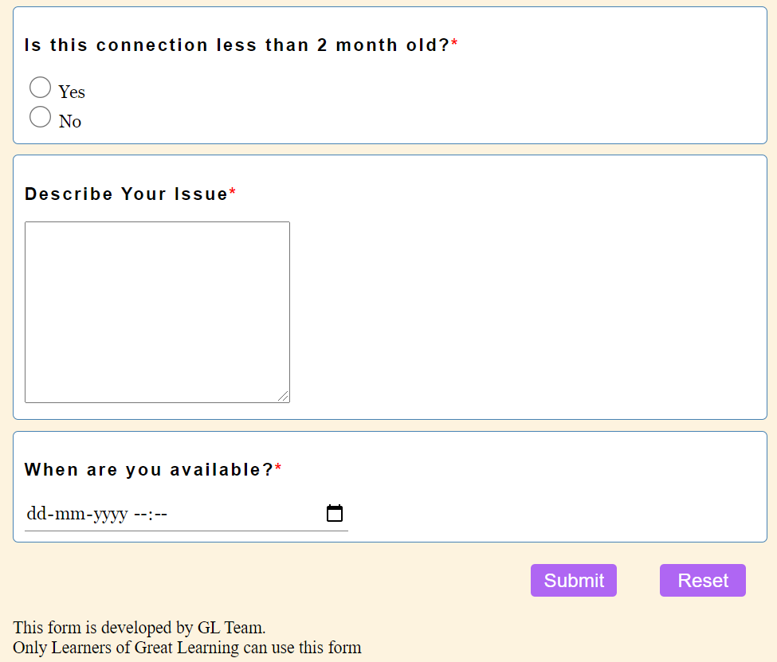
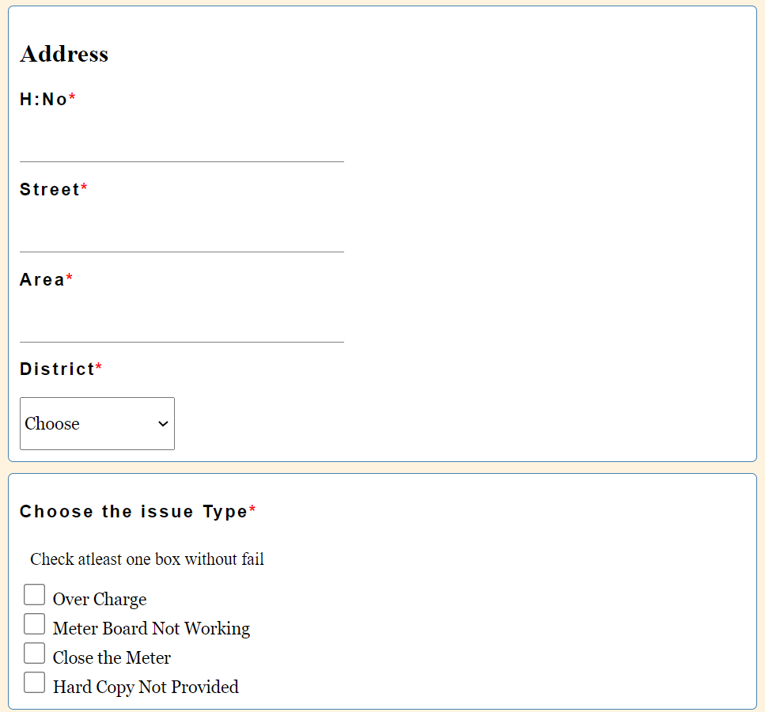
Output

Slide 13
Problem Statement 2
Create a blog post on the top “3 evils that Martin Luther King has spoken about.”
create a header with sign In option on the top right Name the blog post website as “We Blog”
create an advertisement and fix it in the background.
Make the title well seen and an image of the legend below.
On to the left of the page place other blog post links written by the author.
Now describe the issue one after the other. After every issue write a summary
At the end of first and second summary make sure that there is a page gap so that the advertisement in the background is well seen.
create a comments section for readers so that they can share their thoughts on the post.
create a copyright message at the bottom

Slide 14
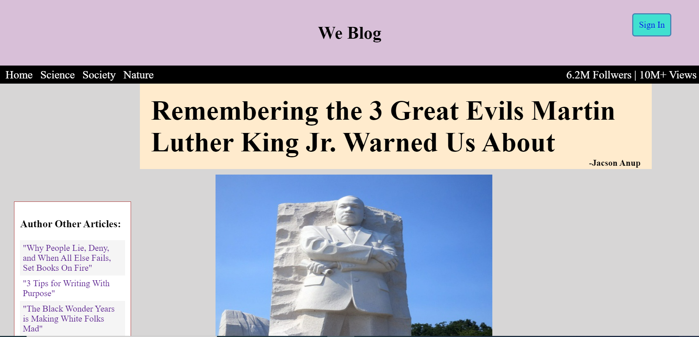
Output

Slide 15
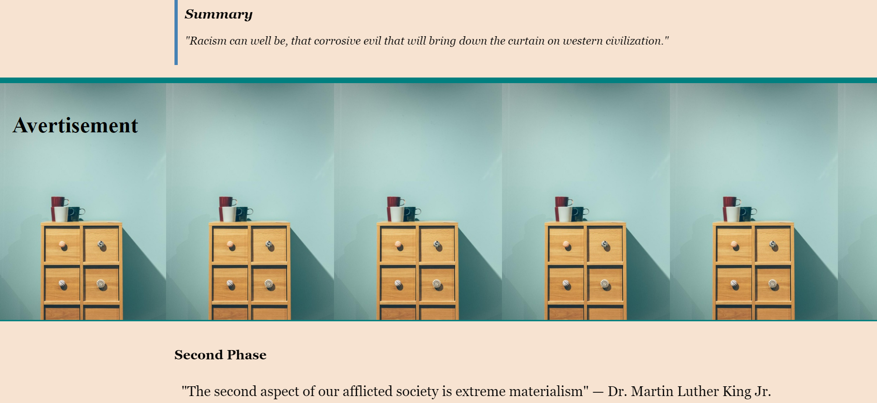
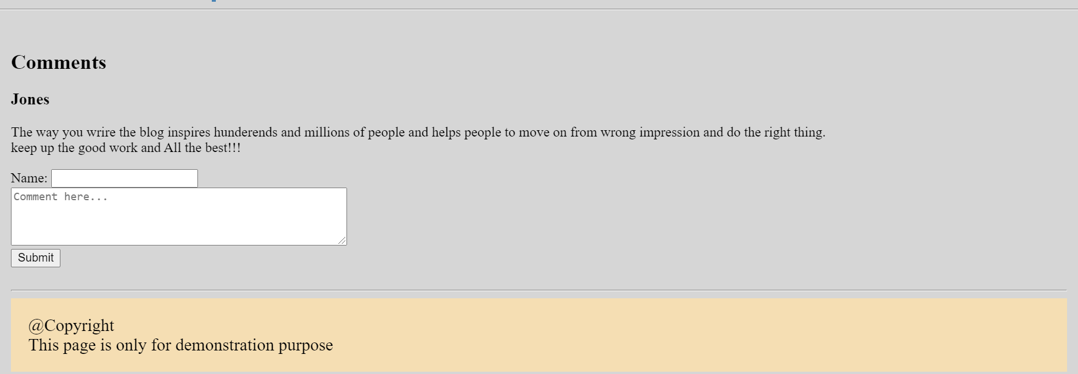
Output

Slide 16
Thank You

